Slide 1
Data Structures
Trees & Graphs

Slide 2
Operations on BST
Creation and Insertion
Recursive Traversal:
  Preorder, Inorder and Postorder
Count Nodes
Count Leaves
Level by level Traversal
Find Minimum, Maximum

Slide 3
Find Height
Find Width
Search- Recursive, Non Recursive.
Non Recursive Traversal:
  Inorder
  Preorder
  Postorder
Deletion from BST
Evaluate Expression Tree

Slide 4
Find Height
Int height (NPTR root)
{
if (root==NULL) return -1 ;
return max( height(root->left), height(root->right) +1) ;
}
Int max( int x, int y)
{
return (x>y ? X : y) ;
}

Slide 5
Find Width
int Width (NPTR root)
{ QUEUE q ; NPTR p ;
int width= -1, count ;
InitQ(&q) ;
addQ(&q,root) ;
addQ(&q,NULL) ;
while (!QEmpty(q) )
{
count = 0 ;
while( (p=delQ(&q) != NULL) )
{

Slide 6
count++ ;
if (p->left != NULL)
addQ(&q,p->left) ;
if (p->right != NULL)
addQ(&q,p->right) ;
}
width = max(count,width) ;
If (!QEmpty(q))
addQ(&q,NULL) ;
}
return width ;
}

Slide 7
Recursive Search
NPTR Search (NPTR root, int elt)
{
if ( (root==NULL) || (root->info == elt) )
return root ;
if (root->info > elt)
return Search( root->right, elt) ;
return Search( root->left, elt) ;
}

Slide 8
Non-recursive Search
NPTR Search (NPTR root, int elt)
{
while ( (root != NULL) && (root->info != elt) )
if (root->info > elt)
root = root->right ;
else
root = root->right ;
return root ;
}

Slide 9
non –recursive Inorder traversal
void Inorder( NPTR root)
{ STACK s;
NPTR p = root ;
InitSTK(&s) ;
do{
while (p!=NULL)
{ push(&s, p) ; p= p->left ; }
if ( !emptySTK (s) )
{ p = pop(&s) ;
printf(“%d”, p->info) ;
p=p->right ;
}
}while(!emptySTK (s) || p != NULL) ;
}

Slide 10
non –recursive Pre-order traversal
void preorder( NPTR root)
{ STACK s;
NPTR p = root ;
InitSTK(&s) ;
do{
while (p!=NULL)
{ printf(“%d”, p->info) ;
if (p->right != NULL)
push(&s, p->right) ;
p= p->left ; }
if ( !emptySTK (s) )
p = pop(&s) ;
}while(!emptySTK (s) || p != NULL) ;
}

Slide 11
non –recursive Post-order traversal
void postorder( NPTR root)
{ STACK s;
NPTR p = root, q= NULL ;
InitSTK(&s) ;
do{
while (p!=NULL)
{ push(&s, p) ; p= p->left ; }
if ( !emptySTK (s) )
{ p = pop(&s) ;
if (p->right ==NULL || p->right ==q)
{

Slide 12
printf(“%d”, p->info) ;
q=p ;
p=NULL ;
}
else
{
push(&s, p) ;
p= p->right ;
}
}
}while(!emptySTK (s) || p != NULL) ;
}

Slide 13
Deletion from BST
NPTR DeleteNode( NPTR root, NPTR p)
{ NPTR r= NULL, q= root ;
while (q != p)
{ r=q ;
if ( q->info <p->info )
q= q->right ;
else
q= q->left ;
}

Slide 14
/* Case 1: node tb deleted has both children*/
If ( p->left != NULL && p->right != NULL)
{ q = p->right ;
r = p ;
while (q->left !=NULL)
{ r=q ;
q=q->left ;
}
p->info = q->info ;
p=q ;
}

Slide 15
/* Case 2: node tb deleted has one child or no child*/
If ( p->left != NULL)
q = p->left ;
else q = p->right ;
If ( r!=NULL )
if (r->left == p) r->left = q ; else r->right = q ;
else
root = q ;
free(p) ;
return root ;
}

Slide 16
Evaluate Expression Tree
float eval(NPTR root)
{
if (root==NULL) return 0 ;
if ( IsOperand(root) ) return root->info ;
return calc( eval(root->left), eval(root->right), root->info) ;
}
float calc(float a, float b, char opr)
{
switch(opr)
{ case ‘+’: return a+b ;
… }
}

Slide 17
Graphs

Slide 18
Graph Creation
  Adjacency Matrix
    Undirected
    directed
  Adjacency List
Traversal
  DFS
  BFS
Connected Components

Slide 19
Spanning Trees
  Kruskal’s algo
  Prim’s algo

Slide 20
Graph Creation- Adj. Matrix
#define MAX 10
typedef struct
{
char nodes[MAX] ;
Int edges[MAX][MAX] ;
} GRAPH ;

Slide 21
void CreateUndirectedGraph( GRAPH *g)
{
int i, n ; char ch ;
printf(“Pls. Enter the number of nodes:“);
scanf(“%d”,&n) ;
printf(“Pls. Enter the names of nodes:“);
for( i= 0; i<n; i++)
g->nodes[i] = getch() ;
for( i= 0; i<n; i++)
for( j= i+1; j<n; j++)
{ printf(“Is node %c connected to node %c? (y/n)“, g->nodes[i], g->nodes[j]);
fflush(stdin) ;
ch = getch() ;
g->edges[i][j] = g->edges[j][i] = (ch==‘y’ || ch==‘Y’);
}
}

Slide 22
void CreateDirectedGraph( GRAPH *g)
{
int i, n ; char ch ;
printf(“Pls. Enter the number of nodes:“);
scanf(“%d”,&n) ;
printf(“Pls. Enter the names of nodes:“);
for( i= 0; i<n; i++)
g->nodes[i] = getch() ;
for( i= 0; i<n; i++)
for( j= 0; j<n; j++)
{ printf(“Is node %c connected to node %c? (y/n)“) g->nodes[i], g->nodes[j]);
ch = getch() ;
g->edges[i][j] = (ch==‘y’ || ch==‘Y’);
}
}

Slide 23
Graph Creation- Adj. List
#define MAX 10
struct node
{
int vertex ;
struct node * next;
} ;
typedef struct node* NPTR ;
typedef struct
{
NPTR edges[MAX] ;
} GRAPH ;

Slide 24
void CreateUndirectedGraph( GRAPH *g)
{
int i, n, vno ; char ch ;
printf(“Pls. Enter the number of nodes:“);
scanf(“%d”,&n) ;
printf(“Pls. Enter the names of nodes:“);
for( i= 0; i<n; i++)
scanf(“%d”,g->edges[i]->vertex) ;
// Enter Edges:
for( i= 0; i<n; i++)
{ printf(“Enter Vertex no.s to which node %d is connected.(Stop by -99)“, g->edges[i]->vertex);
scanf(“%d”,&vno) ;

Slide 25
while (vno!=-99)
{ p= getnode() ;
p->info = vno ;
p->next = NULL ;
if (g->edges[i]->next == NULL)
g->edges[i]->next = tail = p ;
else
{
tail->next = p;
tail = p ;
}
printf(“Enter Vertex no.s to which node %d is connected.(Stop by -99)“, g->edges[i]->vertex);
scanf(“%d”,&vno) ;
} //end-while
}// end-for
}

Slide 26
DFS (Depth First Traversal)
#define TRUE 1
#define FALSE 0
int visited[n] ;
void DFS (int start, GRAPH g)
{
visited[start] = TRUE ;
printf(“%c”,g.nodes[start]->vertex) ;
for( i= 0; i<n; i++)
{
if (g.edges[start][i] && !visited[i])
DFS(i,g) ;
}
}

Slide 27
BFS (Breadth First Traversal)
#define TRUE 1
#define FALSE 0
int visited[ MAX ] ;
void DFS (int start, GRAPH g)
{ QUEUE q ; InitQ(&q) ;
visited[ start ] = TRUE;
addQ(&q,start) ;
while (!QEmpty(q) )
{ vno = delQ(&q) ;
printf(“%d”,g.nodes[vno]->vertex)
for( i= 0; i<MAX; i++)
{ if (g.edges[vno][i] && !visited[i])
{
visited[ i ] = TRUE;
addQ(&q,i) ;
}
}
}

Slide 28
Connected Components
#define TRUE 1
#define FALSE 0
void Conn_Components (GRAPH g)
{
for( i= 0; i<MAX; i++)
visited[ i ] = FALSE;
for( i= 0; i<MAX; i++)
if (!visited[ i ] )
DFS(i,g) ;
}

Slide 29
Kruskal’s Algorithm
T =ø
while (T contains less than n-1 edges AND E is not Empty) do
    Choose an edge (v,w) from E of lowest cost
    Delete edge (v,w) from E
    If edge (v,w) does not create a cycle in T then
      Add edge (v,w) to T
      Else
      discard edge (v,w)
3. If T contains fewer than n-1 edges then print “No Spanning Tree”

Slide 30
Algo: Topological Sort
Procedure TopSort (var g[]:graph, T[]: TopOrder)
visited: array[vertex] of boolean
v : vertex
place : 0..max
Begin
for v = 1 to n
visited[v] = False
end-for
place = n
for v = 1 to n
if ( !visited[v] ) then
sort(v,place)
end-for
End

Slide 31
Procedure Sort (var v:vertex, place: 0..max)
w : vertex
p : pointer to nodes in adjacency list of G
Begin
visited[ v] = True
p = G[v]
While (p!=NULL)
w = p->next
if ( !visited[w] ) then
sort(w,place)
p = p->next
end-while
T[ place] = v
place = place-1
End

Slide 32
Dijksta’s Algorithm
Let graph G=(V,E)
D(w) : Distance from source to vertex w
C(u,w) : weight of edge (u,w)
S : Set of vertices, initially empty.
P(w) : vertex from which v is reached on shortest path from source
Begin
Add source vertex to S
for each vertex w in V-S
D(w) = C(source,w)

Slide 33
Dijksta’s Algorithm
While (V-S is not empty)
let x: vertex which has minimum D(x)
add x to S (and remove from V-S)
for each vertex w in V-S,w adjacent to x
if ( D(x) + C(w,x) < D(w) )
D(w) = D(x) + C(w,x)
P(x) = w
end-if
end-for
end-while

Slide 34
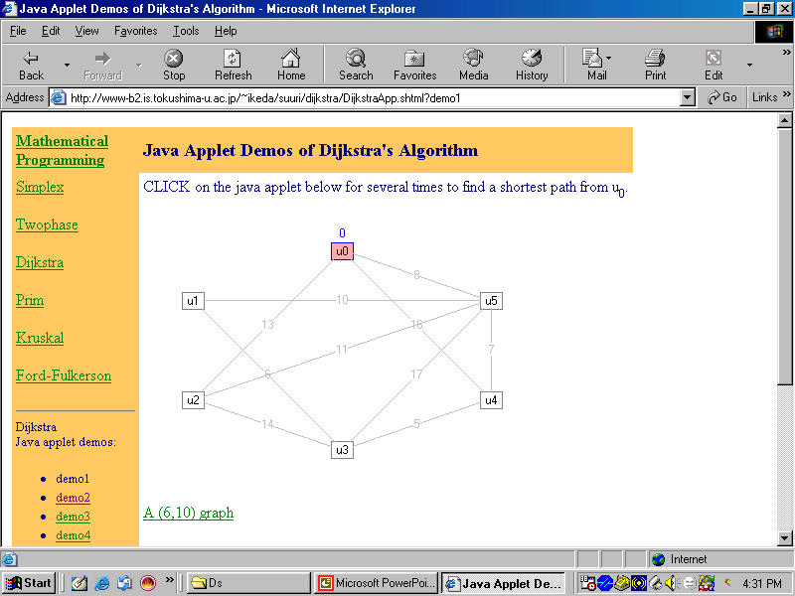

Slide 35
Floyd Warshall’s Algorithm
For each vertex i
For each vertex j
W[i,j] = C[i,j]
End-for
End-for
For each vertex k
For each vertex i
For each vertex j
if ( W[i,k] + W[k,j] < W[i,j] )
W[i,j] = W[i,k] + W[k,j]
End-for
End-for
End-for

Slide 36
Transitive Closure
Floyd's algorithm finds the cost of the least cost path (or the path itself) between every pair of vertices.
Often we only want to know if there is a path between any two vertices (and ignore costs).
Warshall's algorithm is a specialized (but earlier) version of Floyd's algorithm that solves this problem, called the transitive closure of a graph.
Given a directed graph G = (V,E), represented by an adjacency matrix A[i,j], where A[i,j] = 1 if (i,j) is in E, compute the matrix P, where P[i,j] is 1 if there is a path of length greater than or equal to 1 from i to j.

Slide 37
Warshall's Algorithm forTransitive Closure
Warshall (int N, bmatrix &A, bmatrix &P)
{ int i,j,k;
for (i = 0; i < N; i++)
for (j = 0; j < N; j++)
/* There's a path if there's an edge */
P[i][j] = A[i][j];
for (k = 0; k < N; k++)
for (i = 0; i < N; i++)
for (j = 0; j < N; j++)
if (! P[i][j])
P[i][j] = P[i][k] && P[k][j]; }
// Clearly the algorithm is O(N^3).

Slide 38
Activity Network
activity networks are an application of DAGs.
Here each node represents a task to be completed and the directed edges refer to the next tasks and their associated times of completion, as in the following graph:

Slide 39
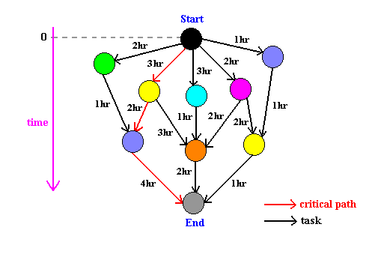

Slide 40
An activity network has at least one critical path, which is the longest sequence of tasks in the project, and therefore the time needed to complete the project.
Examples of activity networks are snow removal (coordination of different vehicles along different streets), cooking pasta (ordering of food purchases and cooking times of various ingredients), and software engineering (interdependence of modules and their deadlines).

Slide 41
Files

Slide 42
Sequential Files
This is the most common structure for large files that are typically processed in their entirety, and it's at the heart of the more complex schemes.
In this scheme, all the records have the same size and the same field format, with the fields having fixed size as well.
The records are sorted in the file according to the content of a field of a scalar type, called ``key''. The key must identify uniquely a record.
This organization is well suited for batch processing of the entire file, without adding or deleting items : this kind of operation can take advantage of the fixed size of records and file;
This organization is easily stored both on disk and tape.
adding and deleting records to this kind of file is a tricky process: the logical sequence of records matches their physical layout on the media storage to ease file navigation, hence adding a record and maintaining the key order requires a reorganization of the whole file. The usual solution is to make use of a ``log file'' (also called ``transaction file''), structured as a pile, to perform this kind of modification, and periodically perform a batch update on the master file.

Slide 43
Indexed Sequential Files
An index file can be used to effectively overcome the above mentioned problem, and to speed up the key search as well. The simplest indexing structure is the single-level one: a file whose records are pairs key-pointer, where the pointer is the position in the data file of the record with the given key. Only a subset of data records, evenly spaced along the data file, are indexed, so to mark intervals of data records.
A key search then proceeds as follows: the search key is compared with the index ones to find the highest index key preceding the search one, and a linear search is performed from the record the index key points onward, until the search key is matched or until the record pointed by the next index entry is reached. In spite of the double file access (index + data) needed by this kind of search, the decrease in access time with respect to a sequential file is significant.
Consider, for example, the case of simple linear search on a file with 1,000 records. With the sequential organization, an average of 500 key comparisons are necessary (assuming uniformly distributed search key among the data ones). However, using and evenly spaced index with 100 entries, the number of comparisons is reduced to 50 in the index file plus 50 in the data file: a 5:1 reduction in the number of operations.

Slide 44
This scheme can obviously be hierarchically extended: an index is a sequential file in itself, amenable to be indexed in turn by a second-level index, and so on, thus exploiting more and more the hierarchical decomposition of the searches to decrease the access time. Obviously, if the layering of indexes is pushed too far, a point is reached when the advantages of indexing are hampered by the increased storage costs, and by the index access times as well.
The main advantage of an indexed sequential file is that records can be processed either sequentially or directly.
Disadvantages:
  Need to create and maintain indices
  Multiple trips to the disk-drive

Slide 45
Disk-Drive Structure
Cheap, non-volatile, fast and direct-access medium
Read/write head operating on all platters and all surfaces

Slide 46
Disk Drive Structure
Surfaces contain tracks
Tracks contain blocks
All tracks with same radius (that line up) = cylinder

Slide 47
Disk Drive Structure
Read/Write Head and Platters (surfaces)
Cylinder 3
Track 3

Slide 48
Index-sequential
Cylinder Index
Highest key
1
52
Index
2
75
3
92
(Retrieve 31)
Track index- Cylinder1
Track index of Cylinder2
Track index of Cylinder3
Highest key
1
18
1
61
1
80
2
39
2
70
2
86
3
52
3
75
3
92
Track Index
Cylinder 1
Data
Tracks
1
11
Record
14
18
2
25
31
39
3
42
49
52

Slide 49
Hashing
Hashing is a method to store data in an array so that storing, searching, inserting and deleting data is fast (in theory it's O(1)). For this every record needs an unique key.
The basic idea is not to search for the correct position of a record with comparisons but to compute the position within the array. The function that returns the position is called the 'hash function' and the array is called a 'hash table'.

Slide 50
Hashing
As with sequential or indexed files, a key field is required for this organization, as well as fixed record length.
However, no explicit ordering in the keys is used for the hash search, other than the one implicitly determined by a hash function.

Slide 51
  Storage and retrieval the same way
  When two keys produce same address collisions occur
  Advantage:
    Indexing not required!
    Access in a constant ( O(1) ) time.

Slide 52
What is a Hash Function?
A hash function H is a transformation that takes a variable-size input m and returns a fixed-size string, which is called the hash value h (that is, h = H(m)).
Hash functions are also used for cryptography, where they need to have some additional properties.
The basic requirements for a cryptographic hash function are:
the input can be of any length,
the output has a fixed length,
H(x) is relatively easy to compute for any given x
H(x) is one-way,
H(x) is collision-free.

Slide 53
What is a Hash Function?
A hash function H is said to be one-way if it is hard to invert, where "hard to invert" means that given a hash value h, it is computationally infeasible to find some input x such that H(x) = h.
If, given a message x, it is computationally infeasible to find a message y not equal to x such that H(x) = H(y) then H is said to be a weakly collision-free hash function.
A strongly collision-free hash function H is one for which it is computationally infeasible to find any two messages x and y such that H(x) = H(y).

Slide 54
Collisions
A collision happens if two different keys return the same hash address from the hash function
if you have a good hash function this happens very rarely

Slide 55
Collision Handling
linear probing: We add a constant number (usually 1) to the position the hash_function returns until we have found an empty place
sqared probing: is very similar to linear probing but we do not simply add the increasing value but we add it's square. This is usually better than linear probing
One disadvantage of probing methods is that they tend to build clusters around already occupied areas of the hash table. A solution to this problem is
double hashing:The idea is to add a value to the hash address that depends on the key of the item, so that the probing order is specific to the key.

Slide 56
Inverted Index
Inverted Lists
  Indices created and maintained as separate files
  Updating simple
  Allows efficient logical operations
    Retrieve records for all employees who are Accountants AND live in Seattle (1 & 7)

Slide 57
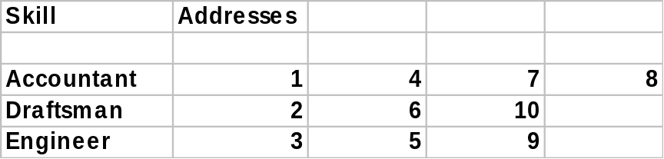
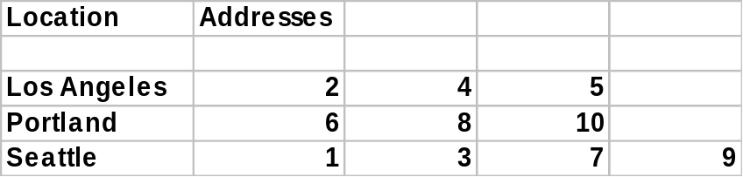
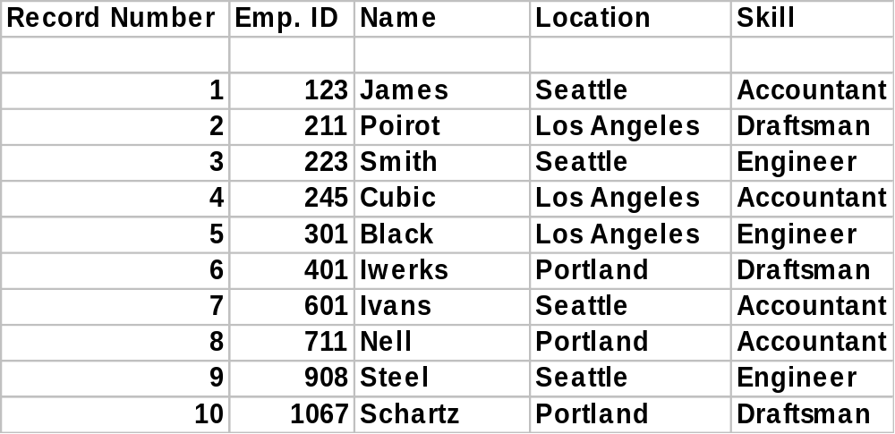
Inverted Index

Slide 58
Inverted index popular in handling structured and unstructured data
Pointers are not stored in the data file
But maintaining large indices become problematic
Large indices can be converted to hierarchical tree structures that are self-balanced

Slide 59
Advanced Direct-Access – Balanced or Binary Key Tree indexes
K1
K2
n or number of pointers= 3
P1
29
P2
P3
18
31
1
3
18
29
31
35

Slide 60
Balanced Tree Index Record (IR)
P
O
I
N
T
E
R
1
P
O
I
N
T
E
R
2
Key1
Key2

Slide 61
Advanced Direct-Access
Trees consists of index records (IR)
IRs contain pointers (n) and keys (n-1)
Root is the top-most IR
Leaves are the bottom-most IRs
Non-leaf IRs always point to other IRs
Leaf IRs point to records on the disk
Path - A set of pointers leading from one IR to another

Slide 62
In a balanced tree (B-tree) all leaves have the same path length from the root
Keys in an IR are always sorted
Left pointer always points to less
Right pointer points to equal or larger value
The above characteristic of B-tree ensures equal access time for all records
Uniform path length is ensured due to strict constraints on update

Slide 63
Building a B-Tree
Enter 31, 3, 18 & 35
31
Enter 3
3
31
Enter 31
Enter 18
31
Enter 35
31
3
18
31
3
18
31
35

